Slide 1
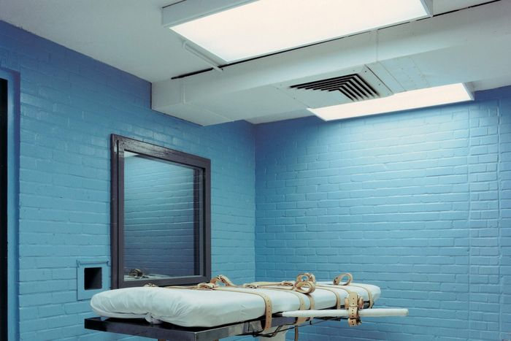
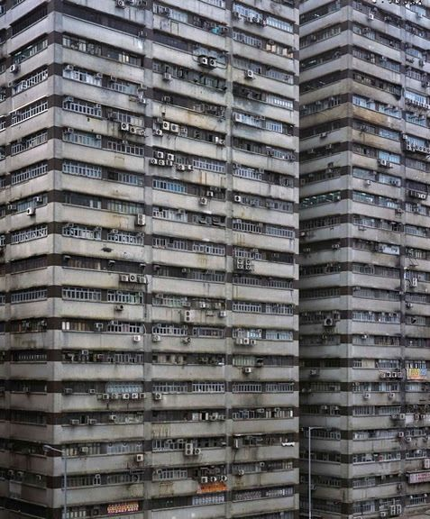
"2 B R 0 2 B" by Kurt Vonnegut

Slide 2
Who is Kurt Vonnegut?
Kurt Vonnegut, an American writer, born in 1922, died in 2007. He is noted for his satirical novels in which he frequently used elements of fantasy and science fiction to highlight the horrors and ironies of 20th-century civilization.
His short stories were concerned with technology and the future, which led some critics to classify Vonnegut as a science fiction writer, though he resisted the label.
His works generally draw pictures of a completely mechanized and automated society, a society that has dehumanized people.

Slide 3
"2 B R 0 2 B" by Kurt Vonnegut
Plot Summary:
This short science fiction story (pronounced "To be or not to be") gives you a glimpse into a world where people do not age . It is a satiric short story that imagines life (and death) in a future world where aging has been “cured” and population control is mandated and administered by the government.

Slide 4
"2 B R 0 2 B"
The title refers to the phone number that people can call to set up their appointment with the gas chambers. Since no one gets any older thanks to new medicines, and to control population growth, an adult must volunteer to die if someone wishes to birth a new baby.

Slide 5
Plot summary
The setting is a society in which aging has been cured, individuals have indefinite lifespans, and population control is used to limit the population of the United States to forty million, which is maintained through a government-assisted suicide. In short, for someone to be born, someone must first volunteer to die. As a result, births are few and far between, and deaths occur primarily by accident.

Slide 6
The scene is a waiting room at the Chicago Lying-In Hospital, where Edward K. Wehling, Jr. is faced with the situation that his wife is about to give birth to triplets, but he has found only one person, his maternal grandfather, who will volunteer to die. A painter on a stepladder is redecorating the room with a mural depicting famous doctors and nurses; particularly, Dr. Benjamin Hitz, the hospital's Chief Obstetrician. Leora Duncan, from the Service Division of the Federal Bureau of Termination, arrives to pose for the mural. It is a picture of a garden that is well taken care of and is a metaphor for the United States at the time. Later, Dr. Hitz enters the scene and converses with everyone but the painter of the mural.

Slide 7
It becomes apparent to all that Wehling is in a state of despair since he does not want to send his grandfather and two of his children to death. Dr. Hitz questions Wehling's belief in the system and tries to make Wehling feel better by explaining how the surviving child will "live on a happy, roomy, clean, rich planet." Suddenly, Wehling draws a revolver and kills Dr. Hitz, Leora Duncan, and himself, "making room for all three children."

Slide 8
The painter, who is about 200 years old, is left to reflect on the scene and thinks about life, war, plague, and starvation. Descending the stepladder, he initially takes the revolver and intends to kill himself with it but is unable to do so. Instead, he calls the Bureau of Termination to make an appointment. The last line is from the receptionist at the Bureau: "Thank you, sir," said the hostess. "Your city thanks you; your country thanks you; your planet thanks you. But the deepest thanks of all is from all of the future generations."

Slide 9
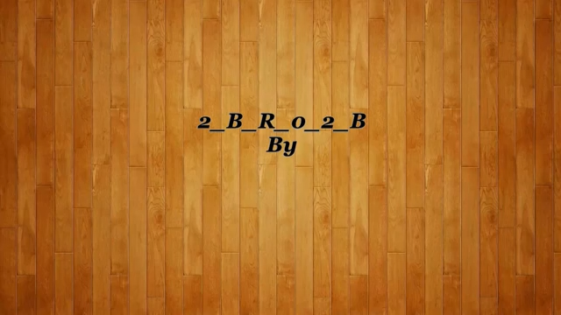
Read and Listen.

Slide 10
Analysis Themes
This story presents a dystopian future where the main problem is world overpopulation. As a solution to this problem, the government set up a law that stipulates that for every child born, one person must volunteer to die.

Slide 11
Government control is one of this story themes; the government controls the population by mandating that each new life come at the price of a suicide. Dr. Hitz is a vocal proponent of population control, representing the voice of government reason.
In the story, Dr. Hitz scolds (reproaches ) Wehling for being miserable about having to choose between his newborn children. Dr. Hitz describes the situation before population control as unsustainable (unmanageable), with no food or water to support the ever-growing population.

Slide 12
Individuality and Freedom.
Dr. Hitz's talk with Wehling suggests a detached, almost bureaucratic understanding of life. He seems entirely unable to understand the impossible choice that Wehling faces, because he sees no individuality, only numbers.Thus, Wehling's suicide is a final expression of his right to control his own fate. By refusing to let his grandfather die, he is implicitly refusing to take part in his society's demands.

Slide 13
Lack Of Individuality
One expression of individuality that has been suppressed and controlled in "2BR02B" is art. The painter is unhappy because he is forced to paint a mural that does not represent life as he understands it. The Happy Garden of Life depicts an impossibly formal, well-tended garden that is a metaphor for the world.
Every body is interchangeable in the painting; in fact, they have already been painted. He merely fills in the blank circles above them with faces, which again evokes the theme of a lack of individuality.

Slide 14
Questions About the Story A. Comprehenion Questions:
What ills did the society hope to cure by eliminating unplanned death? Were they successful? What problems did they create? They hoped to create a perfect world void of all ills, where people never age. They only succeeded in creating the opposite, a world where life has lost all meaning and value.
What does Dr. Hitz value and how does he justify his work? With which of his values do you agree or disagree, and why? Dr. Hitz values order and the system of population control. I agree with his intentions, the world in this story apparently faced an incredibly fast deterioration. I don’t agree with the way Hitz values human lives, every human life is unique, and it’s completely wrong to murder a newborn baby because it’s makes the world more manageable.
What ethical considerations are faced by the father of the triplets, Wehling? What choice does he make and why? What should be the consequences of his action, if any? Wehling has to somehow choose two of his newborn children to send off to die along with his grandfather, but he doesn’t want to kill any of them. He chooses instead to kill Dr. Hitz and Leora Duncan and himself to make room for all three of his children, yet in doing this he leaves his children without a father and his wife without a husband.
What do you anticipate will be changed by Wehling's action and the death of Dr. Hitz? Probably nothing, if the government enforces population control, it’s probably powerful enough to negate the effects of Wehling’s murder-suicide, as for Dr. Hitz he’ll probably be replaced by someone else.
Why does the painter say his dropcloth is a more accurate picture of the world than his mural? What is the reason for his final choice? If I were to guess, a dropcloth is usually one plain color, a bleak uncaring world. One where it is impossible to give life purpose, one where the only thing to do is to go on living life like all others do until you decide to kick the bucket or die on accident.

Slide 15
B. Read and Fill n the balnks.
The main protagonist (character), Edward K. Wehling, Jr. reluctantly sits in the waiting room of a Hospital for his wife, who is giving birth to triplets Wehling must decide which two of his triplets must die, along with his grandfather, in order to not tip the scales of world population. So far, the Wehlings have only been able to find only one volunteer. Hopelessly, he draws a revolver and shoots Dr. Hitz and Leora Duncan Finally, he shoots himself, making room for all three of his children and his grandfather to continue living.

Slide 16
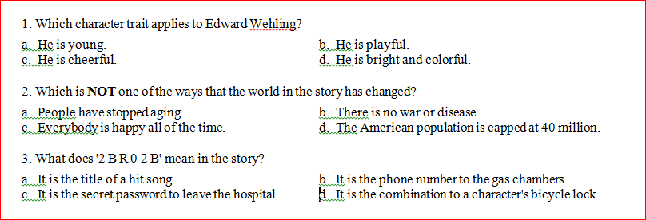
C. Quiz section.

Slide 17
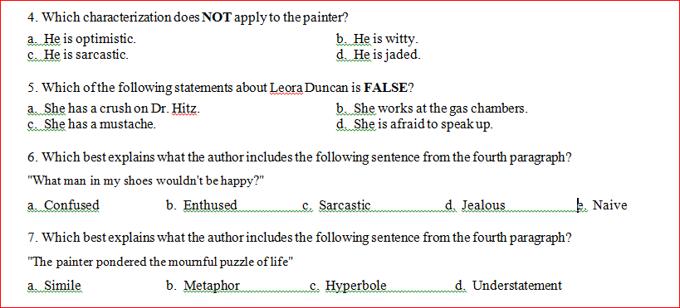

Slide 18
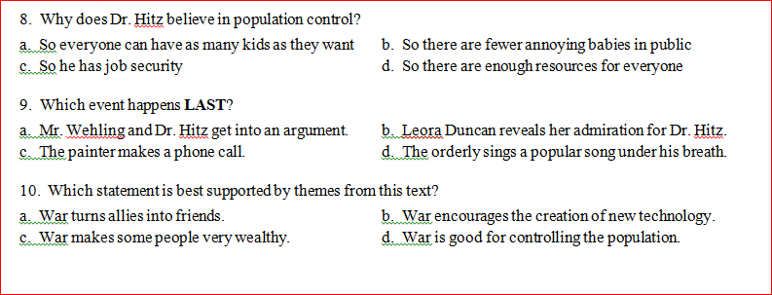

Slide 19
Thank You.

